Slide 1
4.1 NORMALIZATION RECAP
CIS-115

Slide 2
1NF
A relation is said to be in first normal form (1NF) if all data values are atomic
This means that table entries should be single values, not sets or composite objects.
Once in 1NF, you should now be able to identify a PRIMARY KEY or COMPOSITE PRIMARY KEYS(2 fields that together make up a primary key)

Slide 3
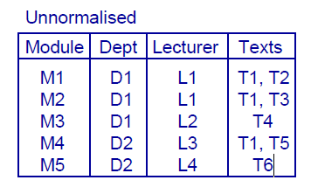
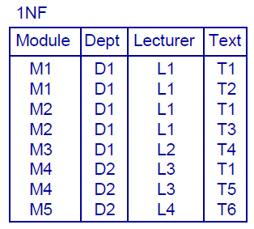
To convert to a 1NF relation, split up any non-atomic values

Slide 4
Identifying Partial dependents
The primary key is {Module, Text} so
{Module, Text} {Dept, Lecturer}
Go through each part of the Primary Key
Do the other fields change only when one
of the primary keys change?

Slide 5
Identifying Partial dependents
The primary key is {Module, Text} so
{Module, Text} {Dept, Lecturer}
Go through each part of the Primary Key
Do the other fields change only when one
of the primary keys change?

Slide 6
Identifying Partial dependents
The primary key is {Module, Text} so
{Module, Text} {Dept, Lecturer}
Go through each part of the Primary Key
Do the other fields change only when one
of the primary keys change?

Slide 7
Identifying Partial dependents
The primary key is {Module, Text} so
{Module, Text} {Dept, Lecturer}
But also
{Module} {Lecturer, Dept}
And so Lecturer and Dept are partially dependent on the primary key

Slide 8
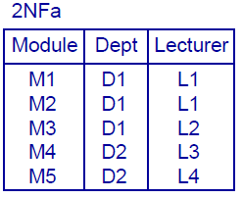
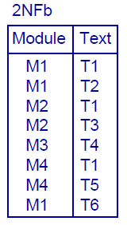
1NF to 2NF

Slide 9
Identifying Transitive dependencies
Transitive dependency is where at least one value in the record isn’t dependent upon the primary key, but on another value in the record.

Slide 10
Identifying Transitive dependencies
Transitive dependency is where at least one value in the record isn’t dependent upon the primary key, but on another value in the record.

Slide 11
Identifying Transitive dependencies
Transitive dependency is where at least one value in the record isn’t dependent upon the primary key, but on another value in the record.

Slide 12
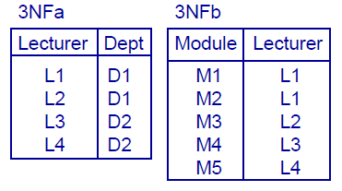
Identifying Transitive dependencies
Transitive dependency is where at least one value in the record isn’t dependent upon the primary key, but on another value in the record.

Slide 13
Identifying Transitive dependencies
Transitive dependency is where at least one value in the record isn’t dependent upon the primary key, but on another value in the record.

Slide 14
Try it out . . . .
A school board has asked you to create a data base to keep track of its tutors. It needs to know which tutors can be used for which courses and which students need tutors in each class. Some students will need multiple tutors, depending on their age (highschool math and history vs grade one) . There is also a stipulation that students must have attended class in the last five days to qualify for tutoring help.
Create a databases from Un-normalized form to 3NF, that would help this school out.

Slide 15
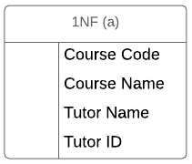
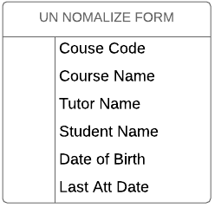
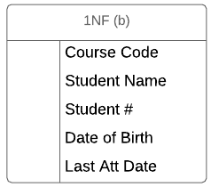
1NF = all data values are atomic

Slide 16
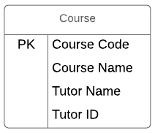
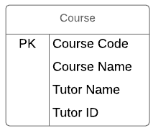
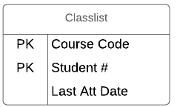
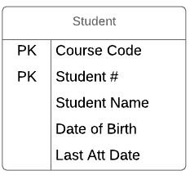
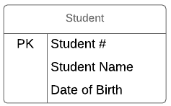
2NF = Partial Dependencies
(Composite keys)

Slide 17
3NF = Transitive Dependencies
(Other Fields)

Slide 18
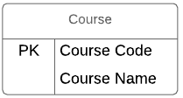
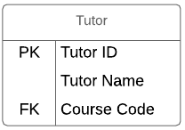
3NF = Transitive Dependencies
(Other Fields)

Slide 19
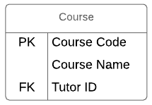
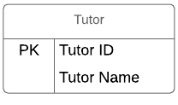
3NF = Transitive Dependencies
(Other Fields)

Slide 20
Finish Lab 3
. . . Or move one to the next assignment . . .

